Slide 1
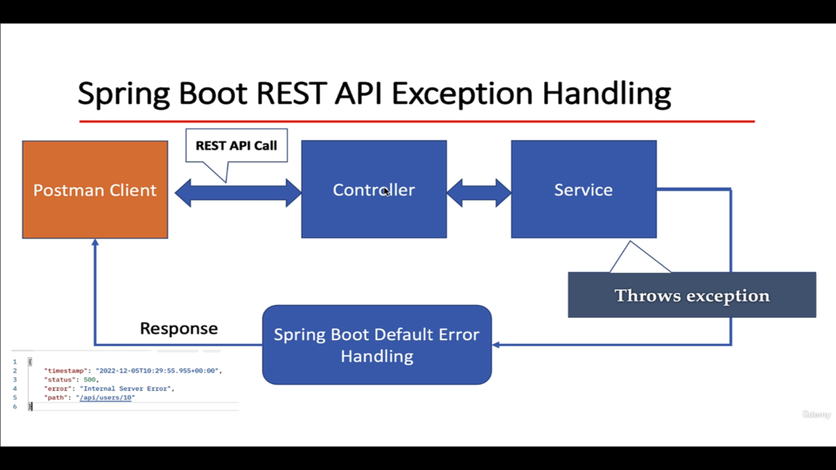

Slide 2
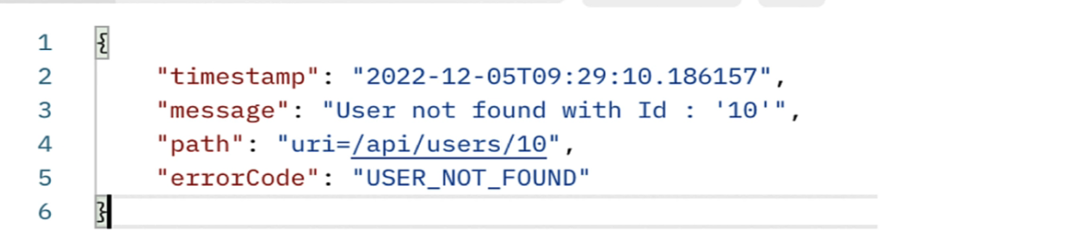
Create and Use Custom Exception
Requirement:
If User does not exist with given id in the database then we need to throw exception with proper error message and status code.

Slide 3
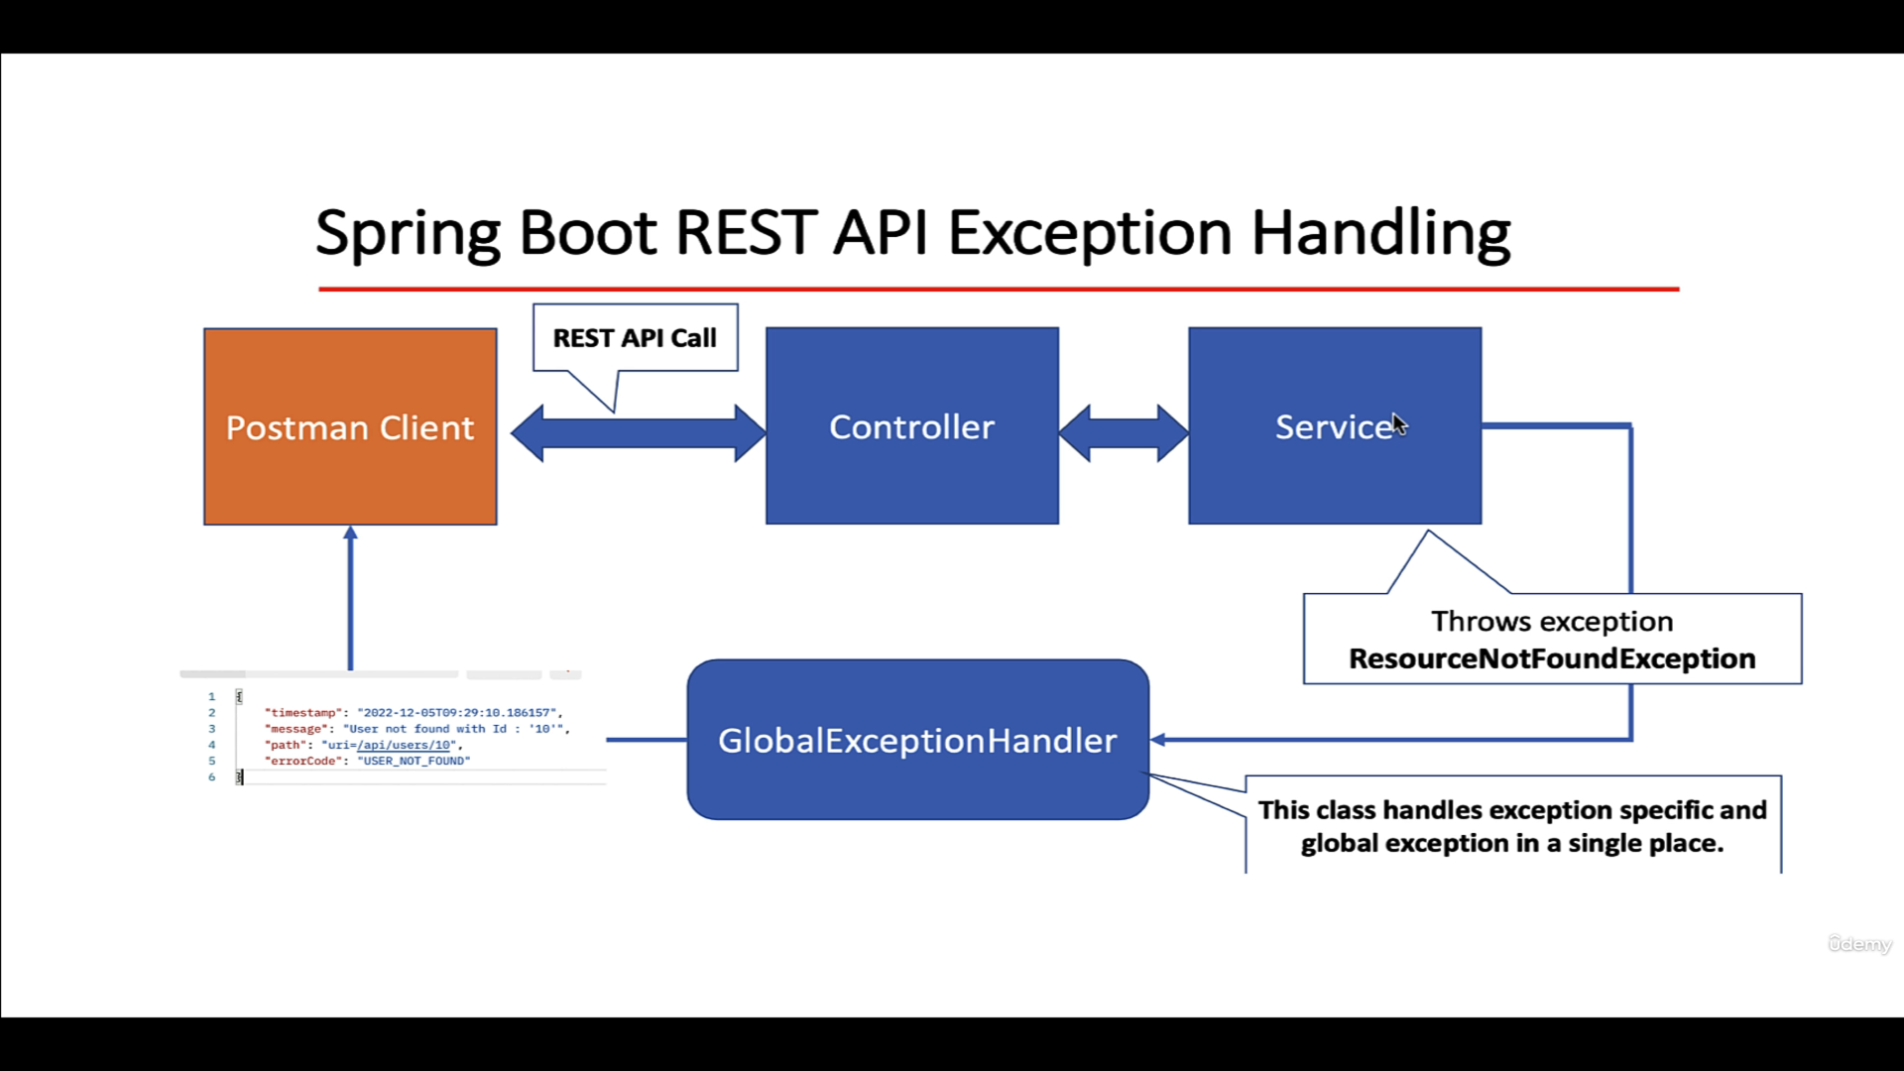

Slide 4
Development Steps
Create and Use ResourceNotFoundException custom Exception
Create ErrorDetails class to hold of the custom error response
Create GlobalExceptionHandler class to handle specific and global exception

Slide 5
@ExceptionHandler
@ExceptionHandler is an annotation used to handle the specific exceptions and sending the custom response to the client.

Slide 6
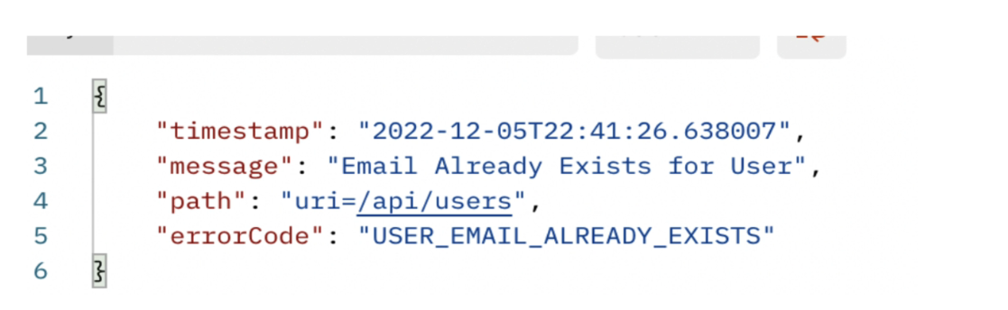
Requirement
If User email already exists in the database then we need to throw exception with proper error message and status code.
EmailAlreadyExistsException

